Slide 1
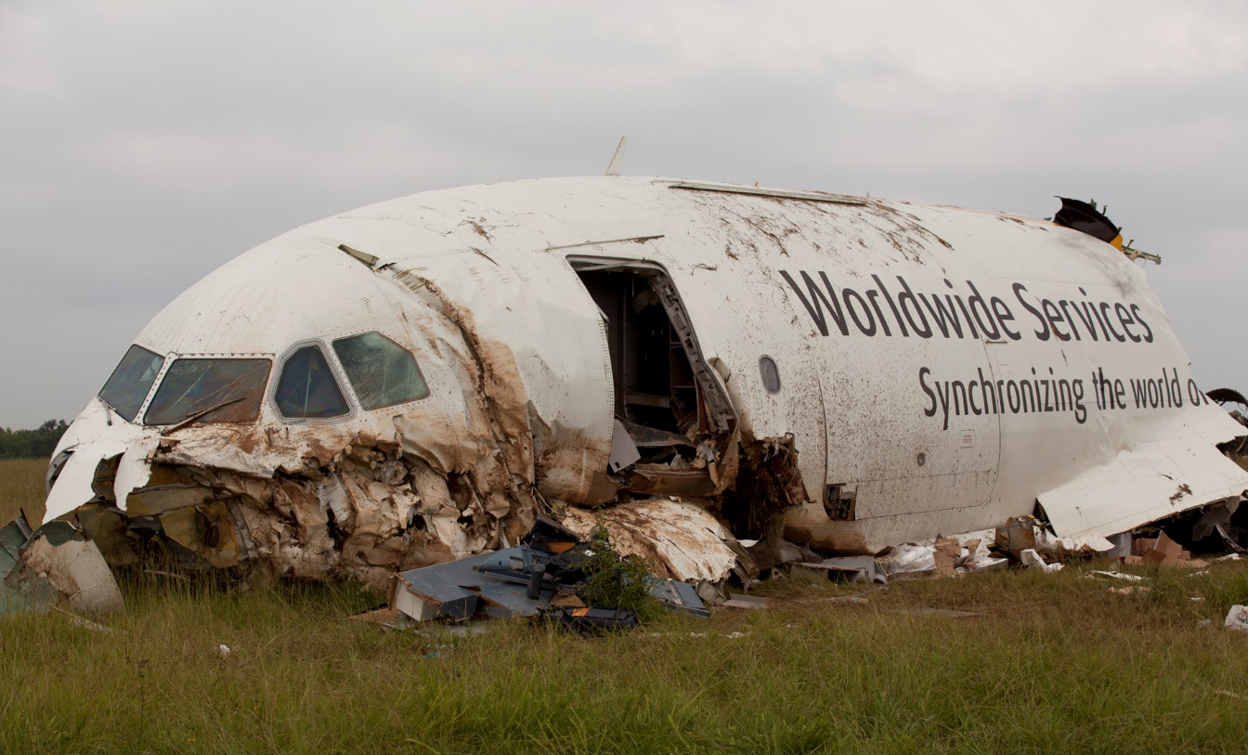
AIRCRAFT ANALYSIS
BY EDEM MOSES

Slide 2
Table of content
Introduction
Problem statement
Objective
Data cleaning
dashboards

Slide 3
INTRODUCTION
The main focus of this research is to perform a detailed analysis of aviation-related fatalities and accidents from 1908 until 2023. The collection includes important information such as crash dates and locations, flight operators, flight details, types of aircraft as well as fatality data.
The aim is to get deep insights into the trends, underlying causes, and patterns of aviation accidents by employing Power BI to build interactive infographics.
The goal of the analysis is to provide important information to stakeholders so they can help lower risks and improve aviation safety.

Slide 4
oBJECTIVES
1. Temporal Analysis:
- Explore temporal trends in airplane crashes over the years.
- Identify patterns in the frequency and severity of incidents.
2. Geospatial Analysis:
- Visualize crash locations on a map to identify hotspots.
- Analyse the distribution of incidents across different regions.
3. Operator Performance:
- Evaluate the safety records of different operators and airlines.
- Identify operators with higher incident rates.
4. Aircraft Analysis:
- Analyse the involvement of specific aircraft types in incidents.
- Examine the relationship between aircraft registration and crash occurrences.
5. Fatality Trends:
- Explore trends in passenger and crew fatalities.
- Investigate factors contributing to fatalities.
6. Route Analysis:
- Analyse incident patterns on specific flight routes.
- Identify routes with a higher likelihood of incidents.

Slide 5
DATA CLEANING
Addressing missing values, standardizing formats, and guaranteeing data correctness and consistency were all part of the data cleaning processthe dataset is well-prepared for precise analysis and well-informed decision-making in aviation safety thanks to the data cleaning and enrichment activities.

Slide 6
DASHBOARD AND INSIGHTS

Slide 7
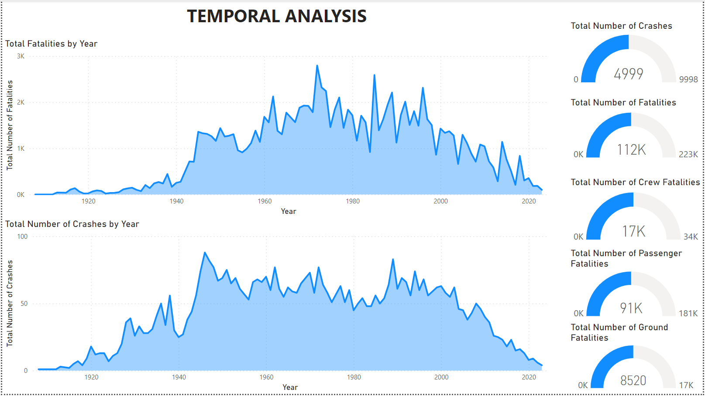

Slide 8
INSIGHTS into temporal analysis
The most number of crashes happened in the year 1946 (88 crashes)
The least number of crashes happened in the year 1908, 1909 and 1912 (1)
The most fatalities happened in the year 1972 (2796 deaths)
The least fatalities happened in the year 1908 and 1909 (1 death)
We had the most crashes in the 4th quarter (1363 crashes)
We had the least crashs in the 2nd quarter (1067 crashes)
Most deaths in the 3rd quarter (31393 deaths)
Least deaths in the 2nd quarter (23715 deaths)
Most deaths in December (10906 deaths)
Least deaths in April (7291 deaths)
Most crashes in December (495 crashes)
Least crashes in April (346 crashes)

Slide 9
A temporal analysis showed that there have been noticeable increases and decreases in the number of aircraft crashes over time. By identifying plausible causes of the variances in crash frequency, additional research into these trends provided information for preventative safety measures.
An analysis of the severity of the incident revealed changes over time in the distribution of minor, serious, and fatal incidents. Exploration of passenger and crew fatality statistics was made easier by interactive visualizations, which showed patterns and connections with variables like aircraft type, operator, and geographic location. The analysis also took into account the percentage of fatalities among passengers (84%) and crew (16%), which helped to clarify the distribution of fatalities within the aircraft.
A thorough investigation revealed the causes of airline crash fatalities including passengers and crew. Through the utilization of sophisticated analytical approaches and the integration of several data sources, the study clarified correlations between variables including aircraft type, weather conditions, and fatality rates. Targeted initiatives with the goal of lowering fatalities and improving aviation safety can be informed by the insights obtained from this investigation.

Slide 10
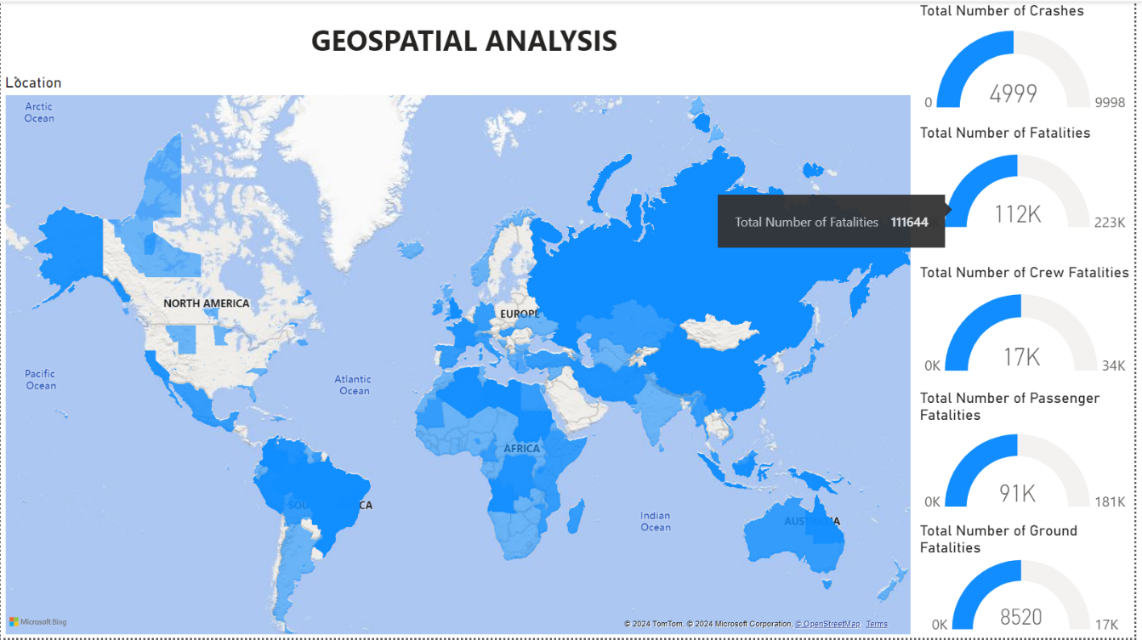

Slide 11
Insights into geospatial analysis
Hotspots of events were found by visualizing crash locations on a global map, allowing stakeholders to concentrate their attention on areas with greater occurrence rates. In order to properly prioritize safety precautions and distribute resources, the distribution of accidents throughout other regions, such as North America, Europe, and other regions, was also examined.

Slide 12
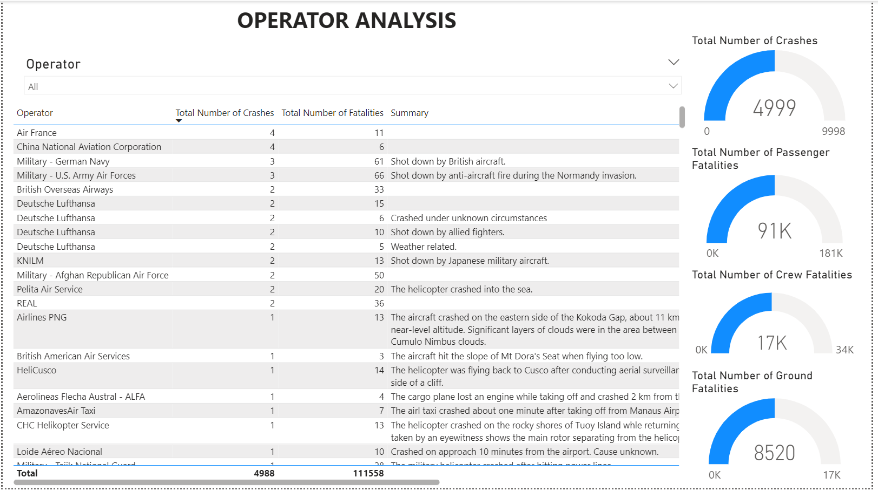

Slide 13
Insights into operator analysis
Air France and China National Aviation Corporation had the most number of Crashes (4 crashes)
Pan American world airways/ klm had the most number of fatalities (583 deaths) due to bombing and radio interference

Slide 14
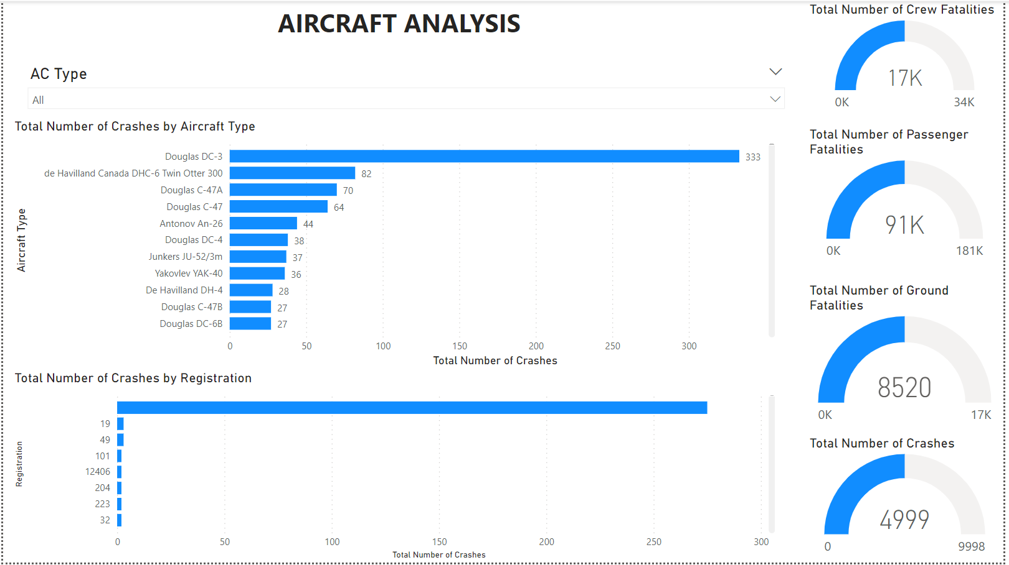

Slide 15
Insights into aircraft analysis
To determine the frequency and severity of occurrences, the involvement of particular aircraft types in those incidents was investigated in detail. Stakeholders can address potential risks and enhance overall safety performance by implementing targeted maintenance schedules, fleet management strategies, and safety regulations by identifying aircraft types with higher incident rates and examining the correlation between aircraft registration and crash occurrences.
Douglas DC-3 had the most number of crash occurences (333 crashes)
Majority of the crashes were from aircrafts without registrations (275 crashes)

Slide 16
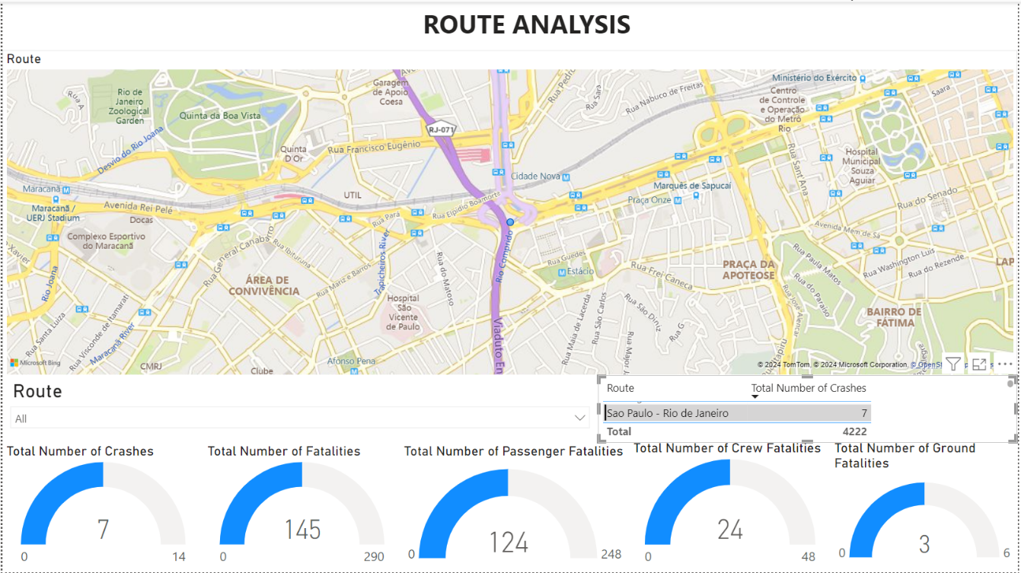

Slide 17
Insights into route analysis
The examination of incident trends along particular flight paths provided information about routes that are more likely to experience incidents. Stakeholders can reduce risks and improve aviation safety standards by making educated decisions about route planning, operating procedures, and safety protocols by assessing incident rates for each route and identifying factors that contribute to incident occurrences.

Slide 18
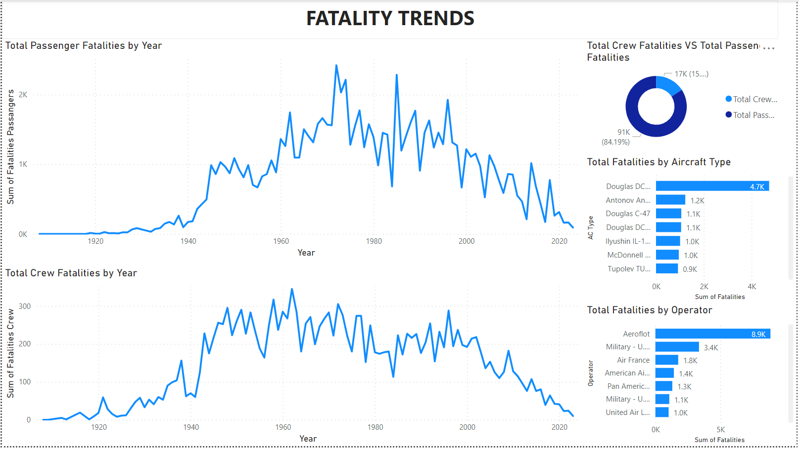

Slide 19
Insights into fatality trends
More passengers died in the crashes (84.19%) than crew members (15.81%)
Douglas DC-3 had the most number of fatalities (4734 deaths)
The Operator Aeroflot had the most number of fatalities (8858 deaths)
Some other factors contributing are aircraft type, Operator, Time(most fatalities occur during the day)

Slide 20
Examining the patterns of deaths among passengers and crew over time showed variations that illustrate the dynamic nature of aviation safety. Stakeholders have a better understanding of how fatalities have changed over time thanks to interactive infographics. This investigation offered insightful information about the efficacy of safety precautions and the effect of legislative modifications on lowering aviation accident mortality.
Investigations into the causes of fatalities have provided crucial information for improving aviation safety protocols. Stakeholders were able to obtain important insights into the underlying causes of airplane event fatalities by examining a number of variables, including aircraft type, operator, weather, and incident severity.
This research made it easier to identify risk variables and provided guidance for focused measures meant to reduce risks and raise safety standards.

Slide 21
conclusion
Our project's main objective is to use insights to improve aviation safety and reduce risks. To that end, we have performed a thorough examination of aircraft disasters and fatalities from 1908 to 2023. Important information including crash dates, locations, operators, flight details, aircraft types, and death figures are all included in the collection. Using powerful data analytics tools like Power BI, we investigated patterns over time, the severity of incidents, and factors that lead to fatalities. We examined the role of particular aircraft types, crash routes and assess geospatial patterns using interactive visualizations.
By combining these insights, we hope to give stakeholders useful information for proactively raising aviation safety standards, which will ultimately lead to a safer atmosphere for air travel.

Slide 22


